Slide 1
Placement of IoT Microservices in Fog Computing Systems:
A Comparison of Heuristics
Bilel Arfaoui
224618@studenti.unimore.it
University of Modena and Reggio Emilia
2024

Slide 2
Introduction
This presentation explores IoT microservice placement within a Fog network, that involve geographically distributed nodes and sensors, focusing on Fog computing solution. We’ll also discuss related challenges and placement strategies within SLA constraints.

Slide 3
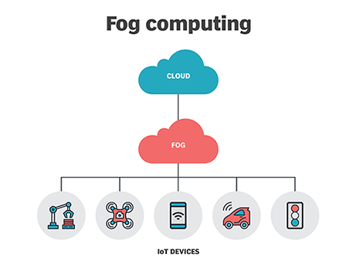
Fog computing
Fog computing brings computational resources closer to end users, improving response times, and reduce data sent upstream.
Hower cloud-based solutions often fall short in Fog environments due to several key differences:
High heterogeneity of nodes
Limited computational resources
Significant delays between Fog nodes
Centralized nature of cloud solutions
Network congestion

Slide 4
Microservices chains
In the microservice paradigm, applications are broken down into small, independent services, and when two or more of these services are interconnected, they form microservice chains.
Example: Microservice chain used for monitoring and logging sensor data in a industrial plant
The microservices of a chain may be allocated over one or multiple fog nodes, and a host may have microservices of different chains

Slide 5
BACKGROUND
AND
PROBLEM DEFINITION

Slide 6
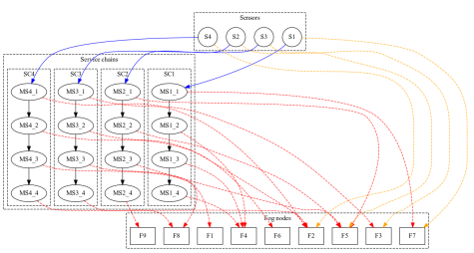
Placement problem
Inputs to the problem
Iot applications modeled in |C| microservice chains with related SLAs
Each chain “c” is composed by |Lc| microservice
|F| Fog nodes
Objectives
Minimize the response time
Comply to the SLAs

Slide 7
Background
Assumptions:
Stable Request rate
A microservice is allocated to 1 and only Fog node
Message length is small
Fog nodes are connected via reliable network links
The SLAs are based on the average service time of the microservices.
Note: some assumption are made for the sake of simplicity

Slide 8
PROBLEM FORMALIZATION
Given the background we formally define the problem, our objectives are minimizing application response time and comply to the SLAs.
Objective function:
min obj(x)=∑ _{c ∈ C} ωc * Rc
Rc is the response time of a single chain.
Wc is the weight given to proportional to the activation frequency.
Constraints:
each microservice is allocated to 1 and only fog node
each fog node must not be overloaded
each microservice must respect the SLA

Slide 9
RESPONSE TIME
The response time Rc of the chain is the sum of the following contributions:
The sum of waiting time for each node
∑_{m∈ C} ∑ _{f∈ F}W_{f}* X_{m,f}
Sum of average service times
∑_{m∈ C} S_{m}
Network delays due to data transfer among microservices in the chain
∑_{m1,m2∈ C} ∑ _{f1,f2∈ F} o_{m1 ,m2}* δ_{f1 , f2}*X_{m1,f1}* X_{m2,f2}

Slide 10
How will we tackle the placement problem?
Due to its complexity caused by the large number of potential microservice/resource combinations, the placement problem is NP-hard, for this reason we will focus on applying the following heuristics:
Modified Best Fit Decreasing (MBFD)
Genetic Algorithm (GA)
Variable Neighborhood Search (VNS)
Afterwards we will compare their performance to evaluate their efficiency in achieving our objectives.

Slide 11
Genetic Algorithm
The Genetic Algorithm is a Biology inspired Heuristic where the solution space is modeled using strings known as chromosomes, each consisting of individual elements called genes.
The algorithm goes through multiple phases until a stopping criterion is reached:
Selection: Chooses the fittest individuals from the population to pass their genes.
Mutation: Introduces random changes to individual genes.
Crossover: Combines genes from selected individuals to create new offspring with mixed traits.
The algorithm evaluates each individual based on a fitness function that measures how well it solves the problem.

Slide 12
Genetic Algorithm
We model the solution space as a population of chromosomes, each with |M| genes where values range from 1 to |F|.
The algorithm runs for 600 generations over 60 individuals with the following strategy:
Tournament selection.
Random mutation with a 0.8% probability.
Uniform crossover with a 0.8% probability.
Objective function acts as Fitness Function.
The fitness function introduces penalties to address Fog Node overloading and SLA non-compliance, calibrated to reflect the severity of violations, enabling early elimination of unacceptable solutions.

Slide 13
Modified Best Fit
This heuristic has been used for the placement of VMs in physical hosts, in this case we adapted it for the placement of microservices over the Fog Nodes.
Iteration:
Iterate over |M| microservices in descending order of mean service time.
Initiate the placement process for each microservice in order.
Placement process:
Iterate over the |F| Fog nodes
Assign the microservice to the node that best optimizes the objective function while meeting constraints and SLA requirements.

Slide 14
VNS - Variable Neighbourhood Search
The VNS heuristic focuses on finding the optimal solution exploring the solution space with local search and diversification strategies to escape local optimas.
The algorithm start by defining an initial solution continues as the following:
Perturbation: Drastic change of the solution to escape local optima and explore new regions.
Local Search: Explores the neighborhood for improvements.
Iterate until a stopping criterion is met

Slide 15
VNS - Local Search and Perturbation
The local search is composed by the following structures:
N1*: Swapping microservices between two Fog Nodes
N2*: Random selection of a random busy Fog Node, and then migration of its allocated microservice to the least loaded Fog Node
The selection of criterion of the microservice is the distance criterion, which can be the delay, number of hops from the data source and/or the traffic volume in the network.
The perturbation phase is composed by the following structures:
L1: Perform every possible swap between the Fog nodes
L2: Perform every possible allocation
Stopping criterion: There is no improvement during the local search phase after the perturbation
*the structure will check the feasibility of the swap/migration

Slide 16
Performance
evaluation

Slide 17
Analysis setup
Performance Assessment
Efficiency: Time taken to achieve a solution.
Solution Quality: Evaluating the effectiveness of the solution.
Metrics
Problem Size: |Lc|, |F| and |C|
Jain Index: Measures load balancing capability of the algorithm [0,1].
Number of Hops normalized to the chain Length
Overall Load (ρ)
Note: During the analysis, we'll adjust specific parameters as needed to better understand performance.

Slide 18
Scalability - Setup
In our initial experiment, we will evaluate the algorithms' capacity to manage load balancing as the number of nodes increases.
To maintain an even distribution of load across the nodes, we will proportionally increase the number of chains as the node count grows.
Fixed parameters
|Lc|=5
ρ = 0.6
Tsla = 10 * ∑ _{m∈ M}S_{m}

Slide 19
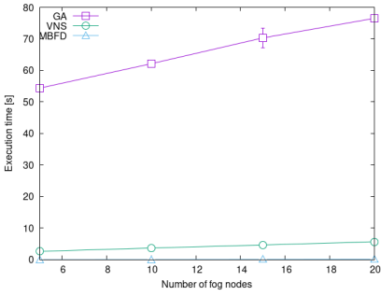
SCALABILITY - Execution time
GA’s is due to the size of the population and high number of generations.
MDBF is almost negligible thanks to its greedy approach.
VNS keeps the size of the neighbourhood small, so their exploration is fast
The increase of the execution time is linear

Slide 20
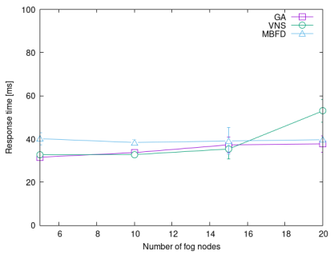
SCALABILITY - Response time
MBFD provides a stable performance
GA and VNS experience degradation

Slide 21
System load - Setup
As for this analysis we will analyze the impact of the global system load over algorithms’ ability of load balancing, optimization of the objective function and the ability of keeping the hops low between subsequent microservices.
Fixed parameters
|Lc|=5
|F| = 10 fog nodes
Tsla = 10 * ∑ _{m∈ M}S_{m}

Slide 22
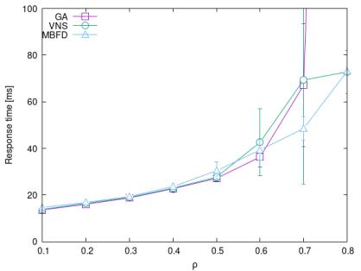
System load - Response time
On low values they are all comparable.
As the load increases the variance and the response time increase with it.
MBFD performs well under heavy work loads.

Slide 23
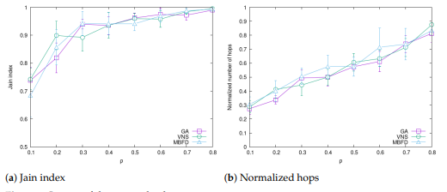
System Load - Jain Index and Normalized Hops
MBFD has a consistently good performance due to it being designed to to guarantee good load balancing
The number of hops increases because the placement of the microservices becomes harder to place near each other without risking overload

Slide 24
Service chain Length - Setup
For the final test, we will assess the impact of increasing the length of microservice chains while keeping the global load constant.
This approach will distribute the load more broadly, allowing us to evaluate how the algorithms perform under these conditions.
Fixed parameters
|F| = 10 fog nodes
ρ = 0.6
Tsla = 10 * ∑ _{m∈ M}S_{m}

Slide 25
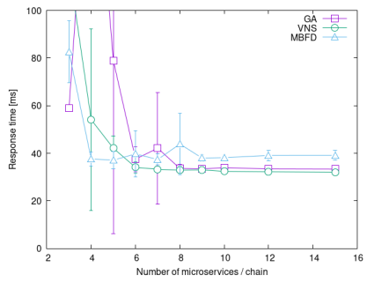
Service chain length - Response time
As the length increases the variance and quality improve
As the chain length increase the load is more spread out, stabilizing the performance and improving the load balancing

Slide 26
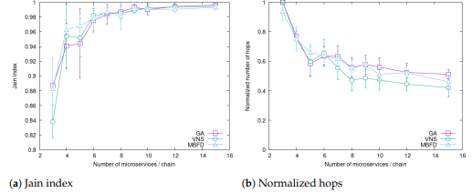
Service chain length - Jain Index and Normalized Hops
MBFD provides good balancing even in short chains, but does reduce hops very well
GA does not perform well
VNS shines here with a high Jain score and low hops

Slide 27
Conclusions
VS
Pros
Cons
Modified Best Fit
Modified Best Fit
Works really well under light/heavy loads, focusing on load balancing, having the best execution time.
Does not take delays into account, causing lower quality solutions with worst response time.
Genetic algorithm
Genetic algorithm
Good response time when scaling up the number of nodes and/or the length of the service chains.
Degradation and high variance at presence of heavy loads/microservices. High execution time.
VNS
VNS
Good execution time, works very well over chain with light microservices, providing good load balancing and optimized hops.
Degradation and high variance at presence of heavy loads/microservices. Also has the worst response time when scaling up.

Slide 28
Thank you for your attention!

